Slide 1
Object Oriented Programming
Lecture 03

Slide 2
Type Conversions
Conversion between integer types and floating point types.
this includes char
No automatic conversion from or to the type boolean.
You can force conversions with a cast .
int i = (int) 1.345;

Slide 3
Operators
An operator is a symbol that tells the compiler to perform a specific mathematical or logical manipulation.
Java has four general classes of operators: arithmetic, bitwise, relational, and logical
Examples of expressions that include Java operators :
n = 2
n += 3
++n
n / 3
n % 3

Slide 4
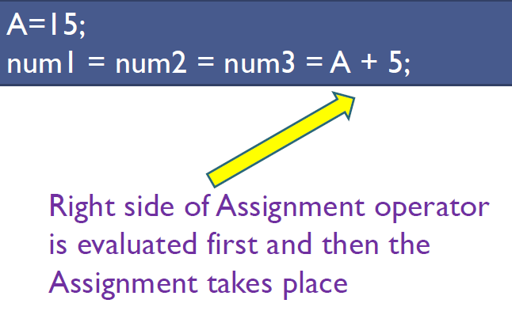
Assignment Operator (=)

Slide 5
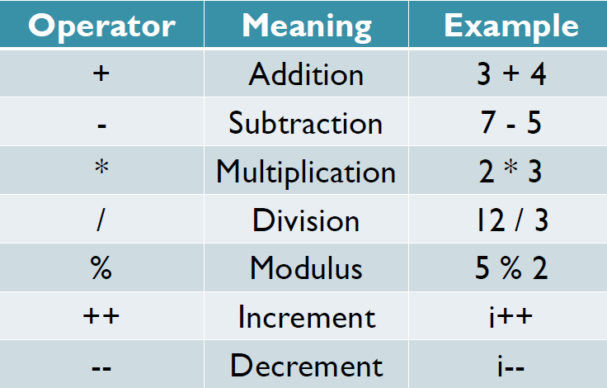
Arithmetic Operators

Slide 6
Arithmetic Operators
x = y / 2;
in the above expression, x and y are variables, 2 is a literal and = and / are operators.
This expression states that the y variable is divided by 2 using the division operator (/), and the result is stored in x using the assignment operator (=).
Notice the expression was described from right to left. It is how the compiler itself analyzes expressions to generate code.

Slide 7
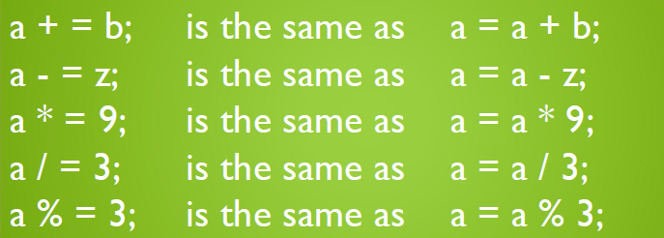
Arithmetic Operators
It is also possible to use the shortcuts for arithmetic operators as given below.

Slide 8
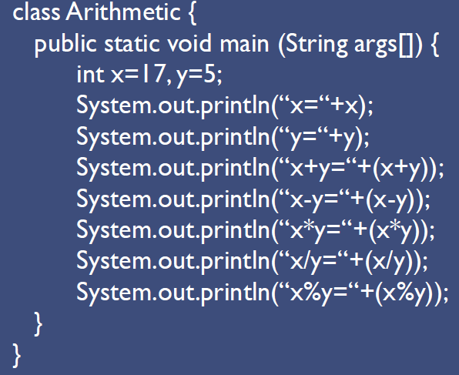

Slide 9
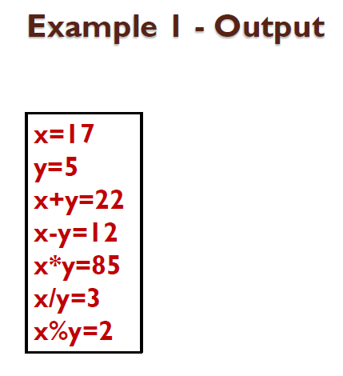

Slide 10
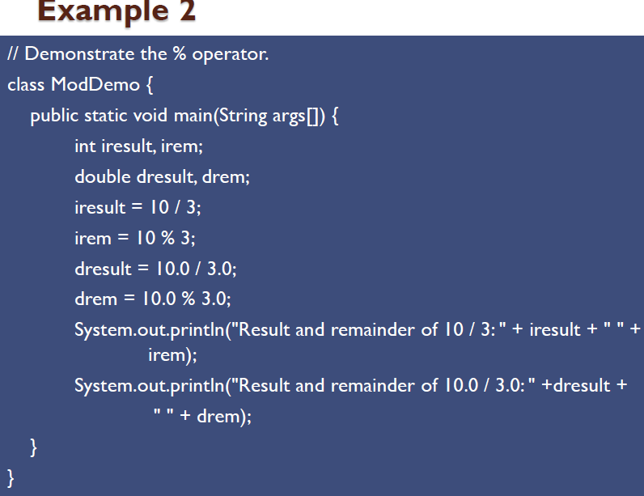

Slide 11
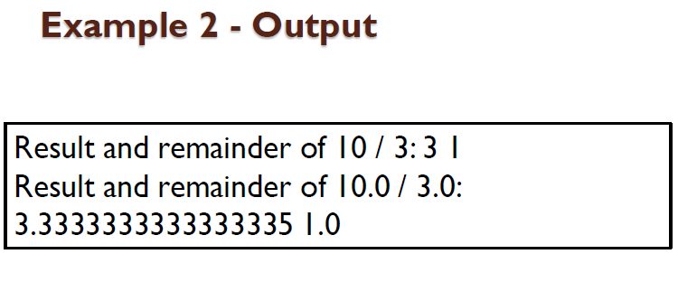

Slide 12
Increment & Decrement
The increment operator adds 1 to its operand, and the decrement operator subtracts 1.
Both the increment and decrement operators can either precede (prefix) or follow (postfix) the operand.
x = x + 1; is the same as x++;
x = x -1; is the same as --x;
x = x + 1; can be written as ++x; // prefix form or as
x++; // postfix form

Slide 13
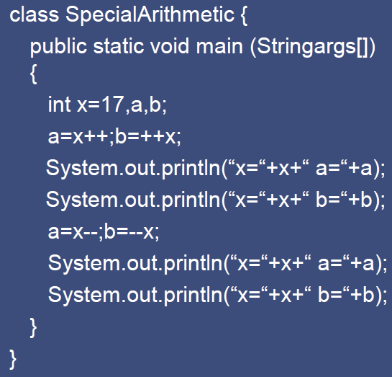

Slide 14
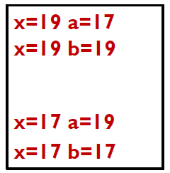

Slide 15
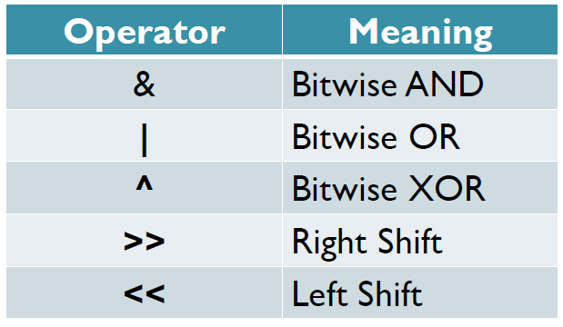
Bitwise Operators
Acts on individual bits of an integer

Slide 16
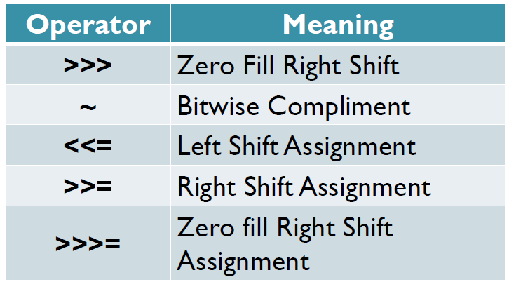
Bitwise Operators

Slide 17
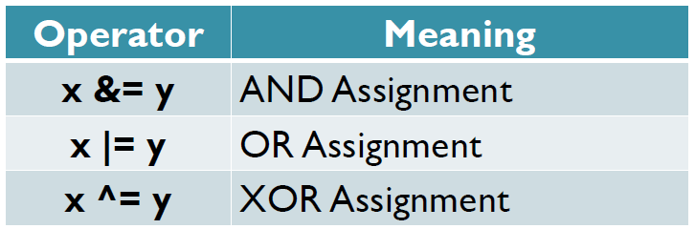

Slide 18
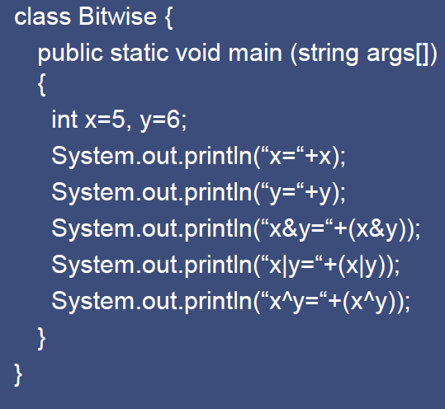

Slide 19
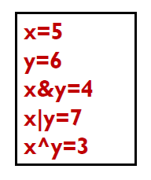

Slide 20
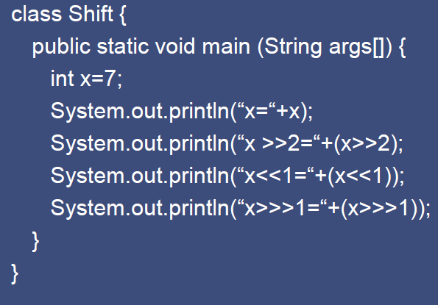

Slide 21
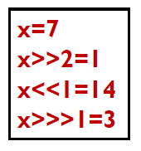

Slide 22
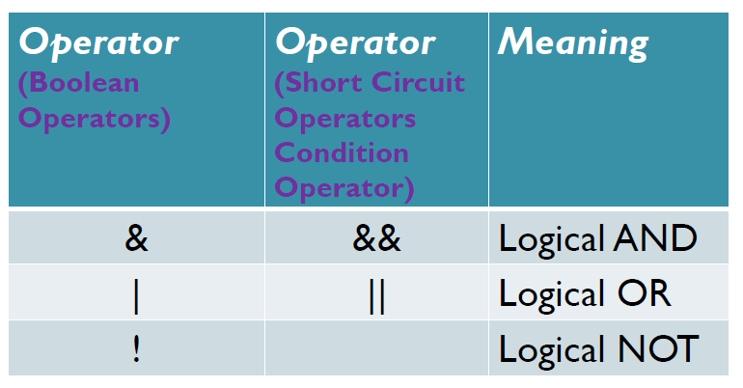
Logical Operators

Slide 23
Logical Operators
When evaluating && and ||, Java will stop the evaluation of the rest of the expression as soon as the outcome becomes clear.
In (dnom!=0 && num / denom>10) second part will not be evaluated if (dnom =0)

Slide 24
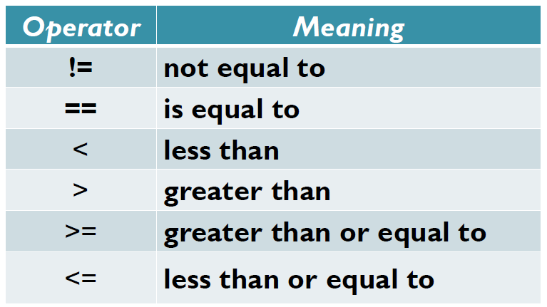
Relational Operators

Slide 25
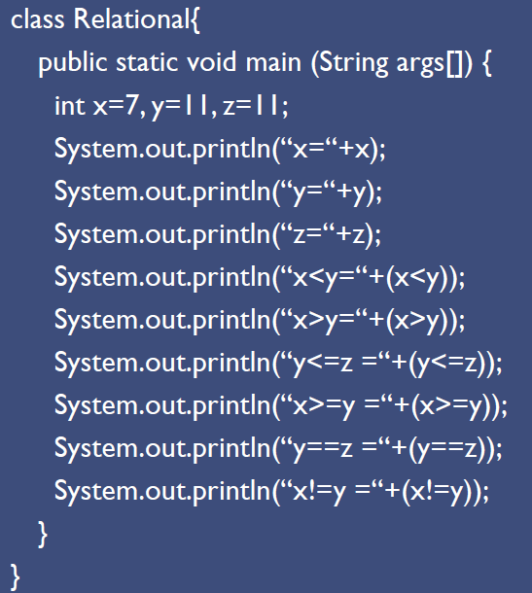

Slide 26
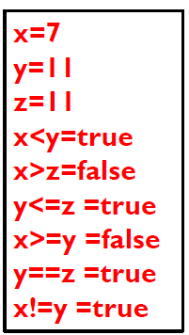

Slide 27
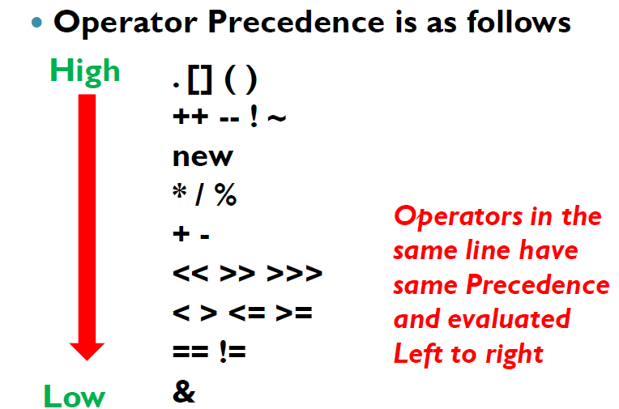
Operator Precedence

Slide 28
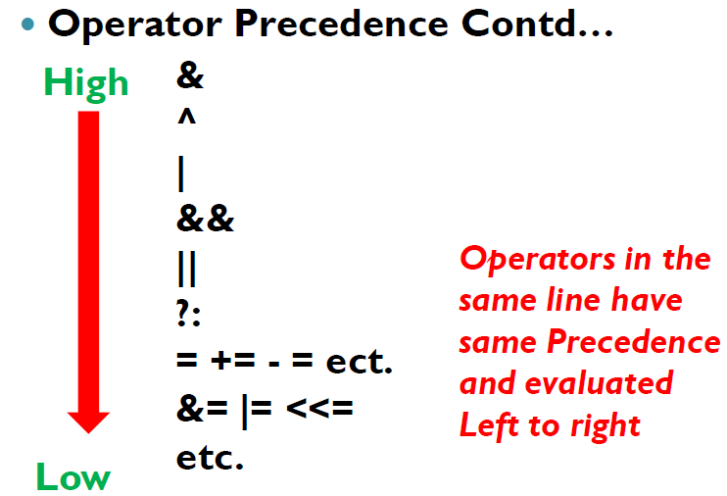

Slide 29
Notes on Operator Precedence
–General order of evaluation is
➢Increment, Decrement operators
➢Arithmetic Operators
➢Comparison Operators
➢Logical Operators,
➢Assignment Operators

Slide 30
